Slide 1
Principal Component Analysis
Prepared By: Maimoona Akram

Slide 2
PCA
Dimensionality reduction technique to help represent data in lower dimensions
Helpful in visualizations and modeling
Naturally comes at the expense of accuracy
The goal is to transform high-dimensional datasets (having a large number of features) into a low-dimensional one (having a smaller number of features) without losing too much information.
Datasets can include images or simple structured datasets.
Deal with the curse of dimensionality, which results in complex models and difficulty in visualizing.
Helps us to remove the Multi-collinearity situation in which some input features are correlated with each other and provide redundant information.
PCA - reduce the number of features/variables of a data set, while preserving as much information as possible

Slide 3
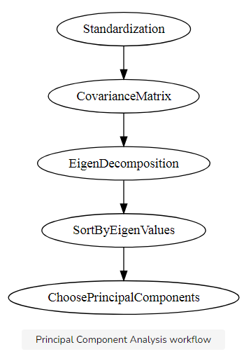
How PCA WORKS

Slide 4
Pca sTEPS
Standardize the range of continuous initial variables
Compute the covariance matrix to identify correlations
Compute the eigenvectors and eigenvalues of the covariance matrix to identify the principal components
Create a feature vector to decide which principal components to keep
Recast the data along the principal components axes

Slide 5
STEP 1: STANDARDIZATION
Standardize the range of the continuous initial variables
Variables with larger ranges will dominate over those with small ranges
Could lead to biased results
After normalization, all the variables will be transformed to the same scale.

Slide 6
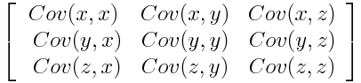
STEP 2: COVARIANCE MATRIX COMPUTATION
The goal of this step is to understand that if there is any relationship between input variables
Correlated variables = redundant information
We’ll use covariance matrix to identify these correlations
p × p symmetric matrix (where p is the number of dimensions)
Covariance matrix is a 3×3 matrix of this from

Slide 7
Cont.
Covariance of a variable with itself is its variance (Cov(a,a)=Var(a))
Thus main diagonal (Top left to bottom right) we actually have the variances of each initial variable
Covariance is commutative (Cov(a,b)=Cov(b,a)),
Means that the upper and the lower triangular portions are equal.

Slide 8
Cont.
Sign of the covariance matters:
If positive then: the two variables increase or decrease together (correlated)
If negative then: one increases when the other decreases (Inversely correlated)

Slide 9
STEP 3: COMPUTE THE EIGENVECTORS AND EIGENVALUES OF THE COVARIANCE MATRIX TO IDENTIFY THE PRINCIPAL COMPONENTS
Eigenvectors and eigenvalues are the linear algebra concepts that we need to compute from the covariance matrix
Eigen-Vectors are also called Principal Components in the context of the topic.
Principal components are new variables that are constructed as linear combinations or mixtures of the initial variables.
Combinations are done in such a way that the new variables (i.e., principal components) are uncorrelated
Most of the information within the initial variables is squeezed or compressed into the first components.

Slide 10
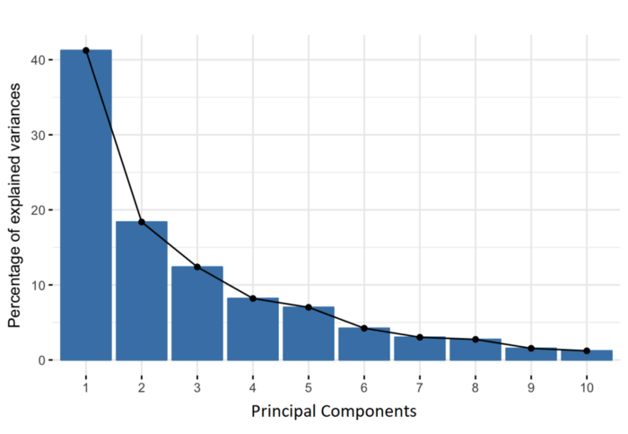
Scree plot
Notes:
idea is 10-dimensional data gives you 10 principal components, but PCA tries to put maximum possible information in the first component, then maximum remaining information in the second and so on, until having something like shown in the scree plot below
Organizing information in principal components this way, will allow you to reduce dimensionality without losing much information, and this by discarding the components with low information and considering the remaining components as your new variables.

Slide 11
Note that
Principal components are less interpretable and don’t have any real meaning since they are constructed as linear combinations of the initial variables.
Geometrically, principal components represent the directions of the data that explain a maximal amount of variance.
In simple terms, lines that capture most information of the data
Notes:
The relationship between variance and information here, is that, the larger the variance carried by a line, the larger the dispersion of the data points along it, and the larger the dispersion along a line, the more information it has. To put all this simply, just think of principal components as new axes that provide the best angle to see and evaluate the data, so that the differences between the observations are better visible.

Slide 12
How PCA Constructs the Principal Components
There are as many principal components as there are variables in the data
First principal component accounts for the largest possible variance, and so on.
Notes:
For example, let’s assume that the scatter plot of our data set is as shown below, can we guess the first principal component ? Yes, it’s approximately the line that matches the purple marks because it goes through the origin and it’s the line in which the projection of the points (red dots) is the most spread out. Or mathematically speaking, it’s the line that maximizes the variance (the average of the squared distances from the projected points (red dots) to the origin). The second principal component is calculated in the same way, with the condition that it is uncorrelated with (i.e., perpendicular to) the first principal component and that it accounts for the next highest variance.
This continues until a total of p principal components have been calculated, equal to the original number of variables.

Slide 13
Eigenvectors and Eigenvalues
Comes in pairs, so that every eigenvector has an eigenvalue.
Their number is equal to the number of dimensions of the data
For example, for a 3-dimensional data set, there are 3 variables, therefore there are 3 eigenvectors with 3 corresponding eigenvalues.

Slide 14
Cont.
Eigenvectors of the Covariance matrix are actually the directions of the axes where there is the most variance(most information) and that we call Principal Components.
Eigenvalues are simply the coefficients attached to eigenvectors, which give the amount of variance carried in each Principal Component.
We construct a total of n principal components where n is the total number of dimensions of the dataset.
By sorting the Principal Components in order of their EigenValues, highest to lowest, you get the principal components in order of significance.
In the last step, we decide the number of Principal Components to keep and choose the ones of greater significance and construct a matrix of vectors that we call Feature Vectors. These are our features in the new lower dimensions.

Slide 15

Data and scatter plot

Slide 16

Subtracting mean

Slide 17

Cont.

Slide 18
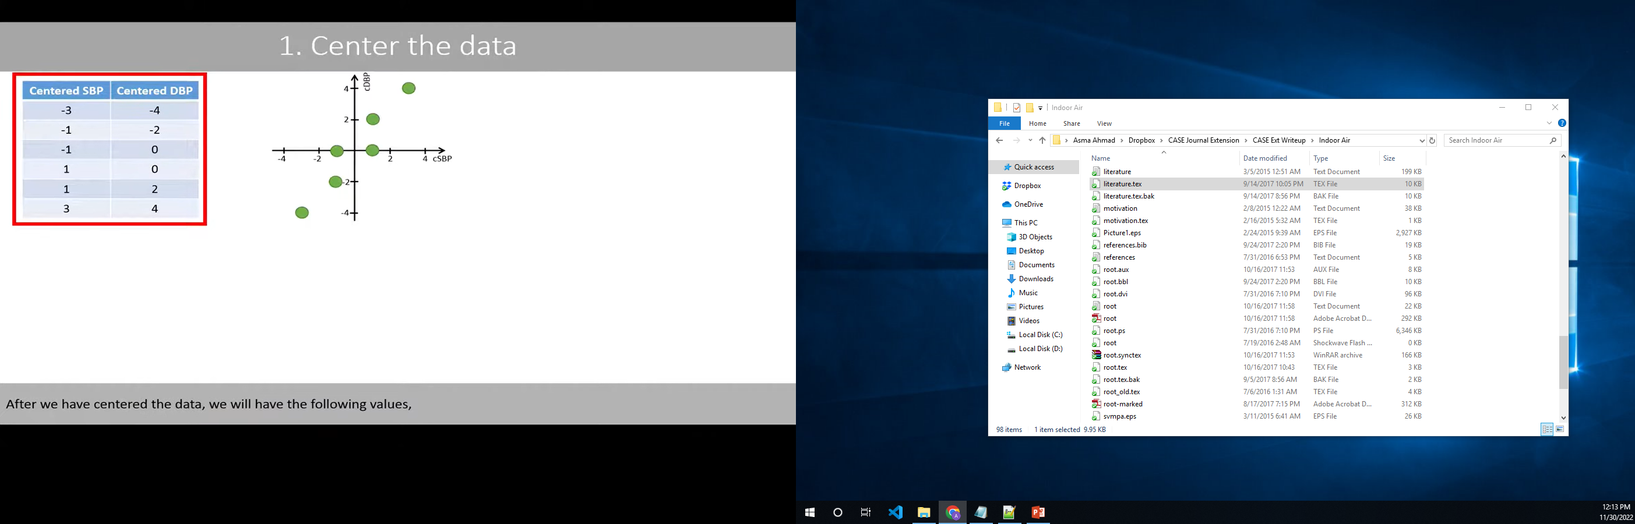

Slide 19

Covariance Matrix

Slide 20

Eigen values and eigen vectors
Calculate Eigen values using
$$\left|A−λI\right|=0$$
where A is the covariance matrix
$λ_{2}=12.08$
$λ_{1}=0.32$
Find the eigen vectors using
$AX=λX$ where $X=\left[{x \atop y}\right]$
For v2 eigen vector=> x is supposed to be 1
For v1 eigen vector => x is supposed to be -1
v2 =$\left[{0.59 \atop 0.81}\right]$ , v1 = $\left[{−0.81 \atop 0.59}\right]$

Slide 21

Eigen vector: unit length vector

Slide 22
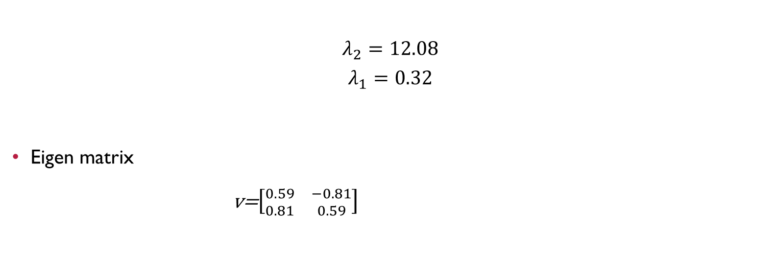
Sort by eigen values
$$λ_{2}=12.08$$
$$λ_{1}=0.32$$
Eigen matrix
v=$\left[{0.59 \atop 0.81} {−0.81 \atop 0.59}\right]$

Slide 23

PRINCIPLE COMPONENTS Calculation

Slide 24

Cont.

Slide 25

Interpret the principle components

Slide 26
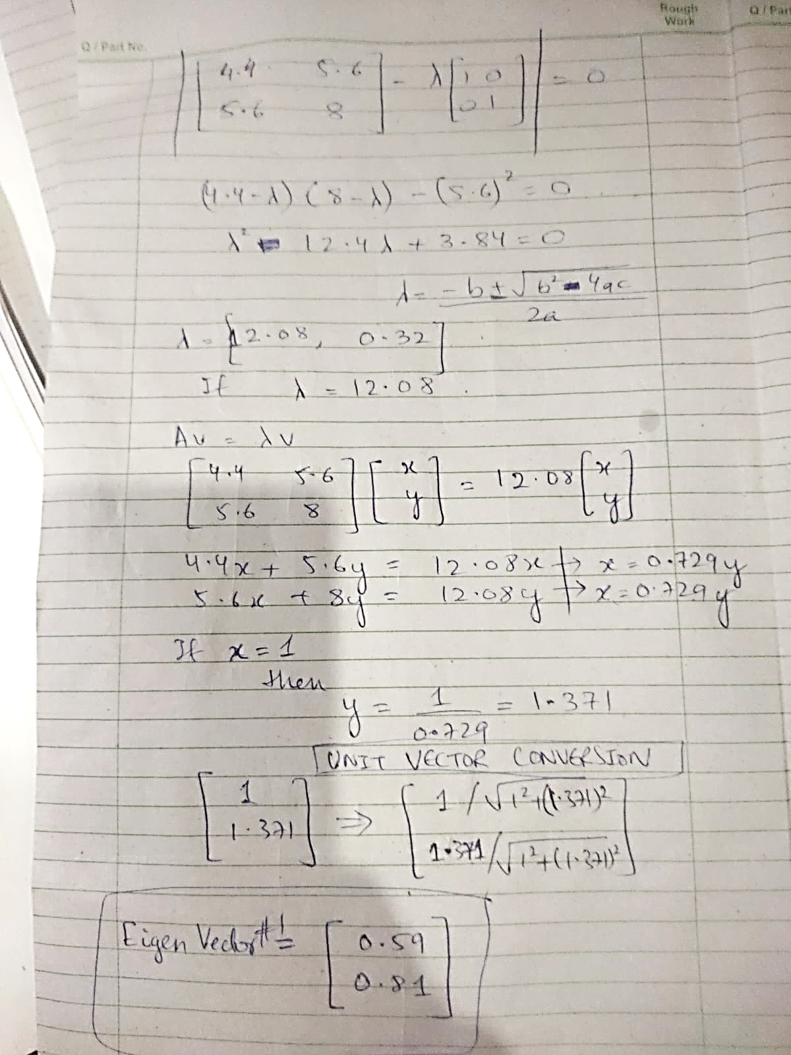

Slide 27
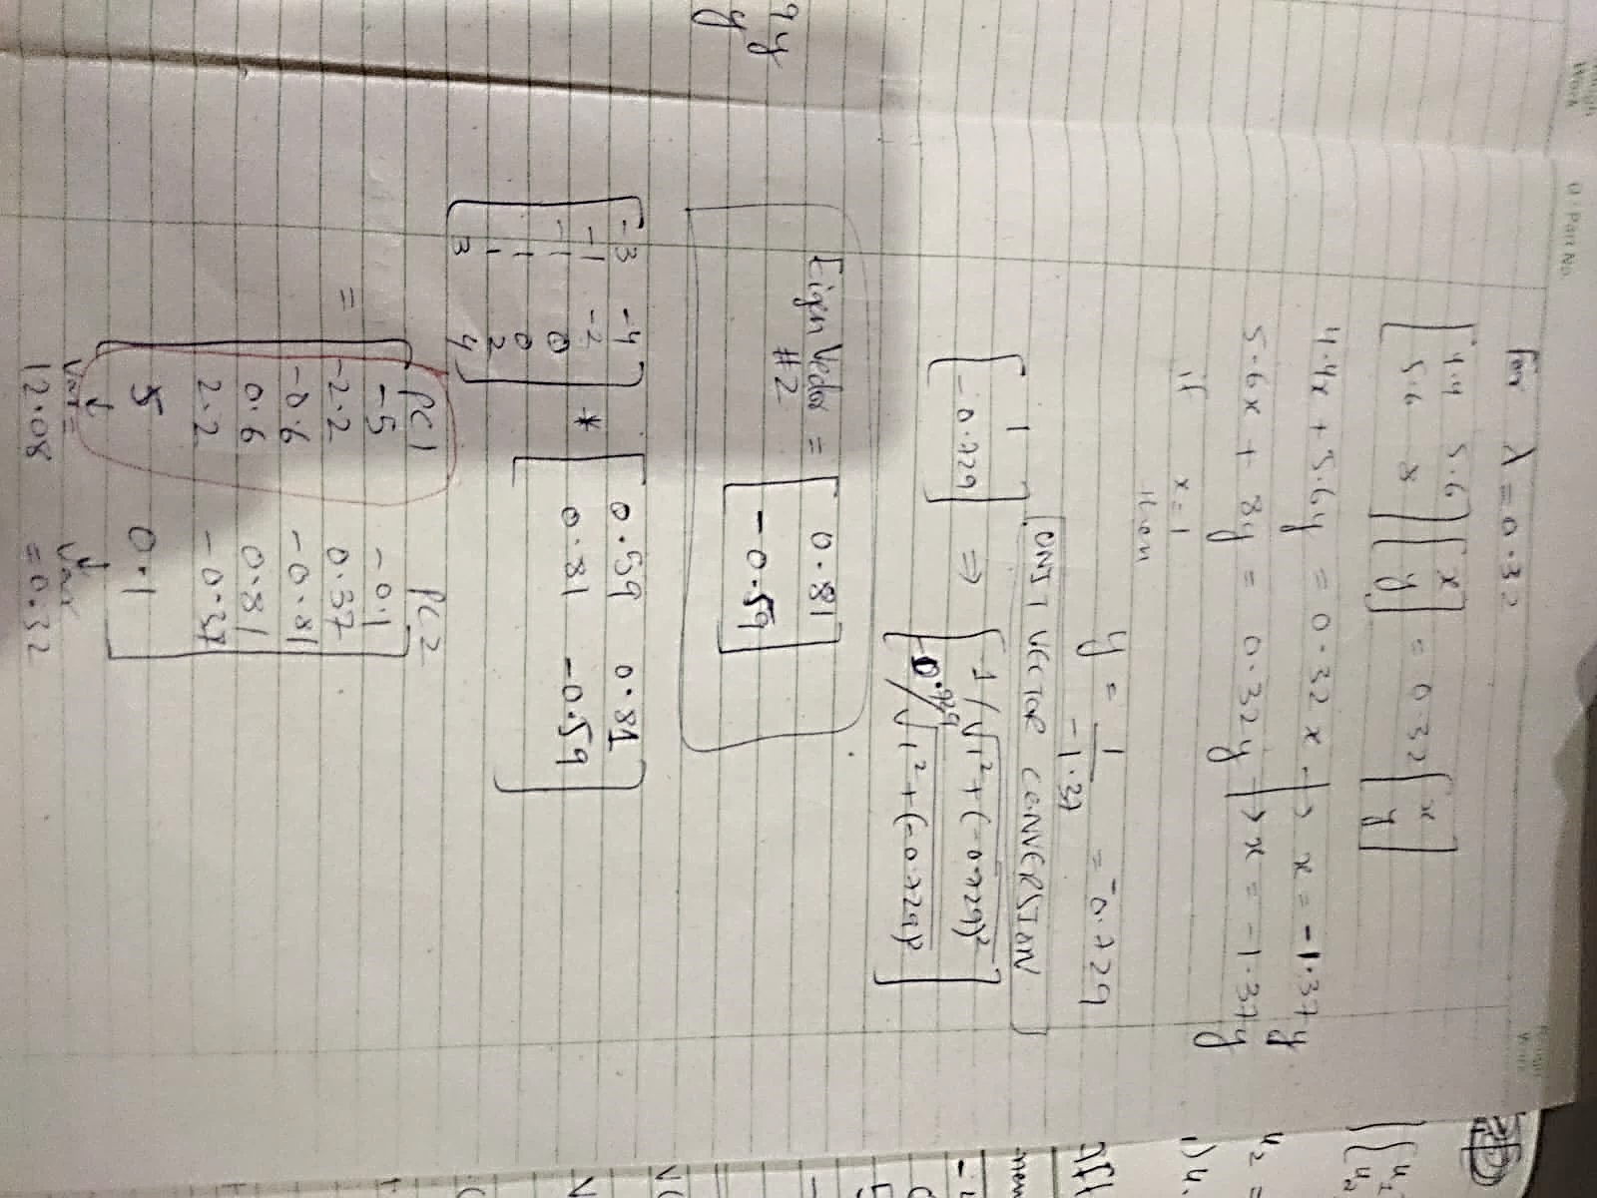

Slide 28
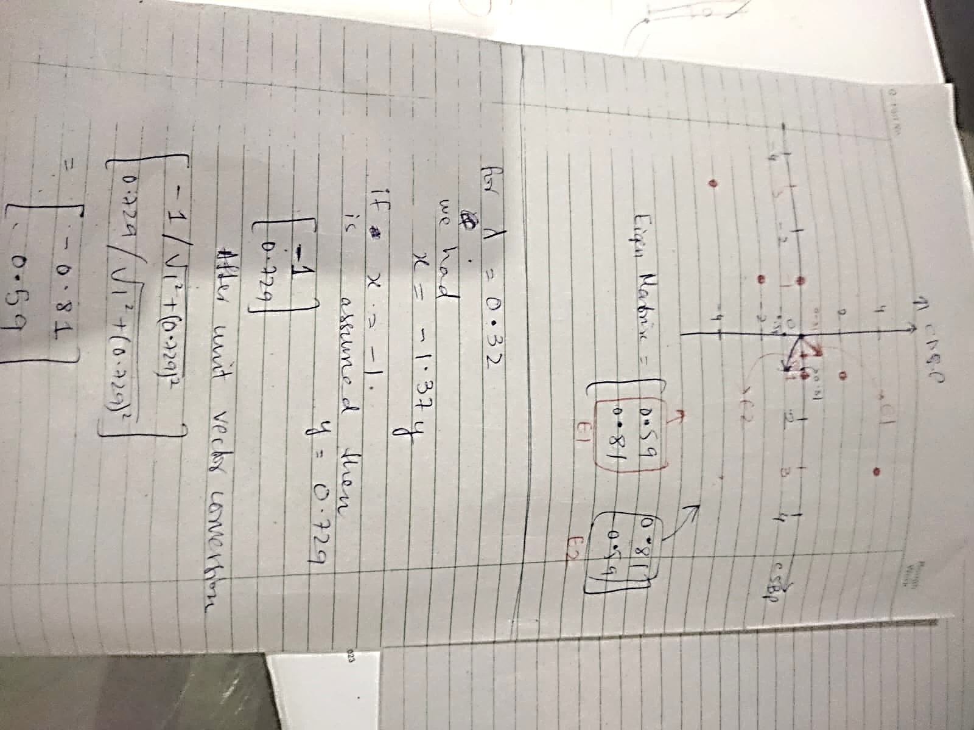

Slide 29
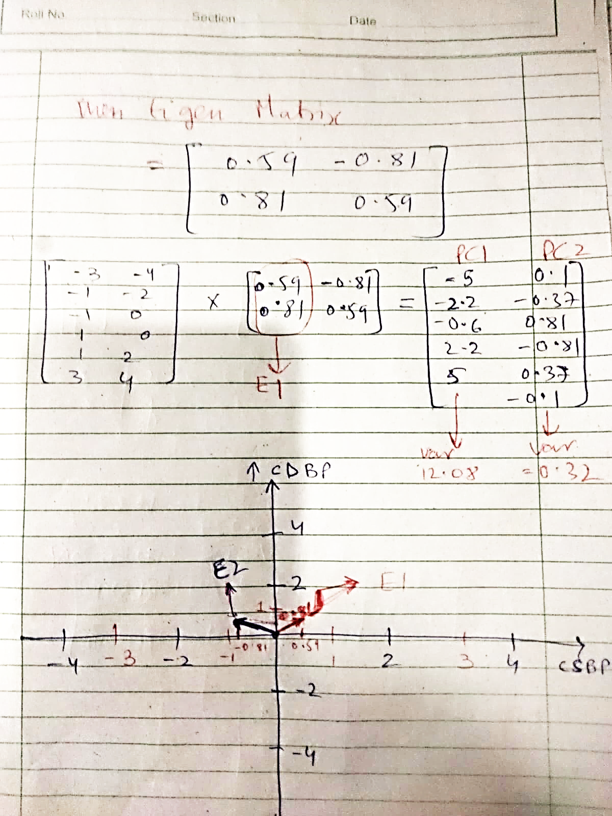

Slide 30
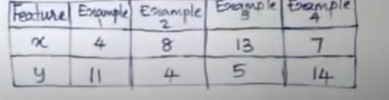

Slide 31
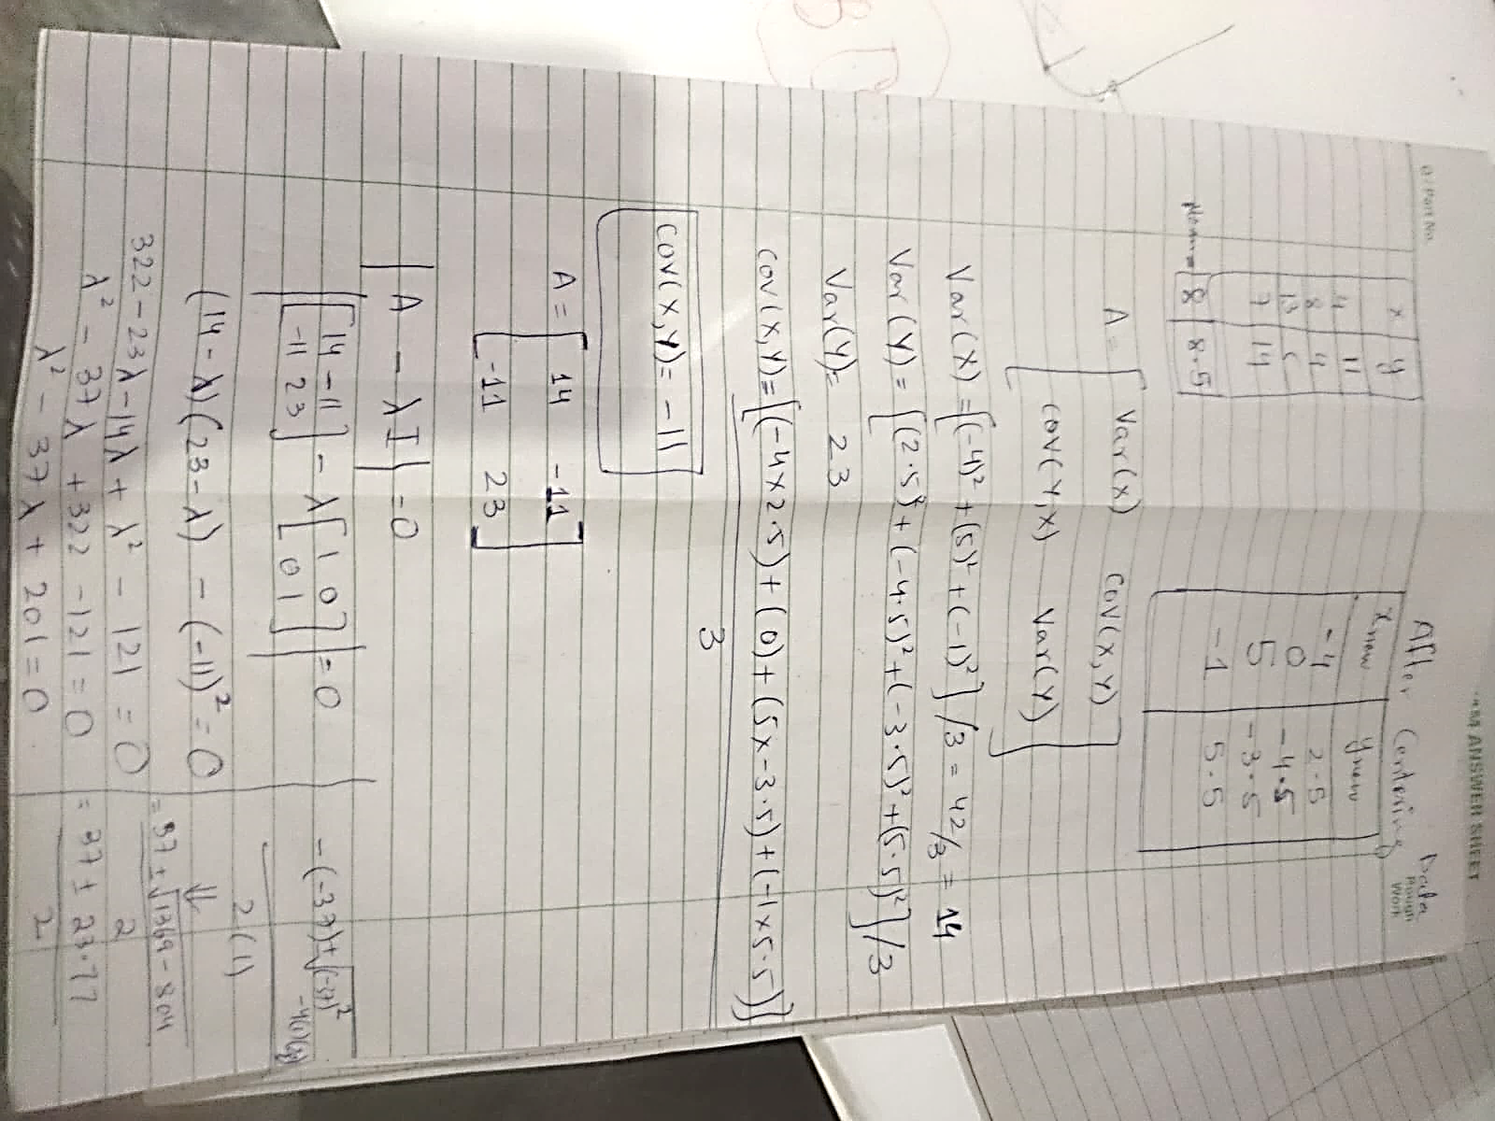

Slide 32
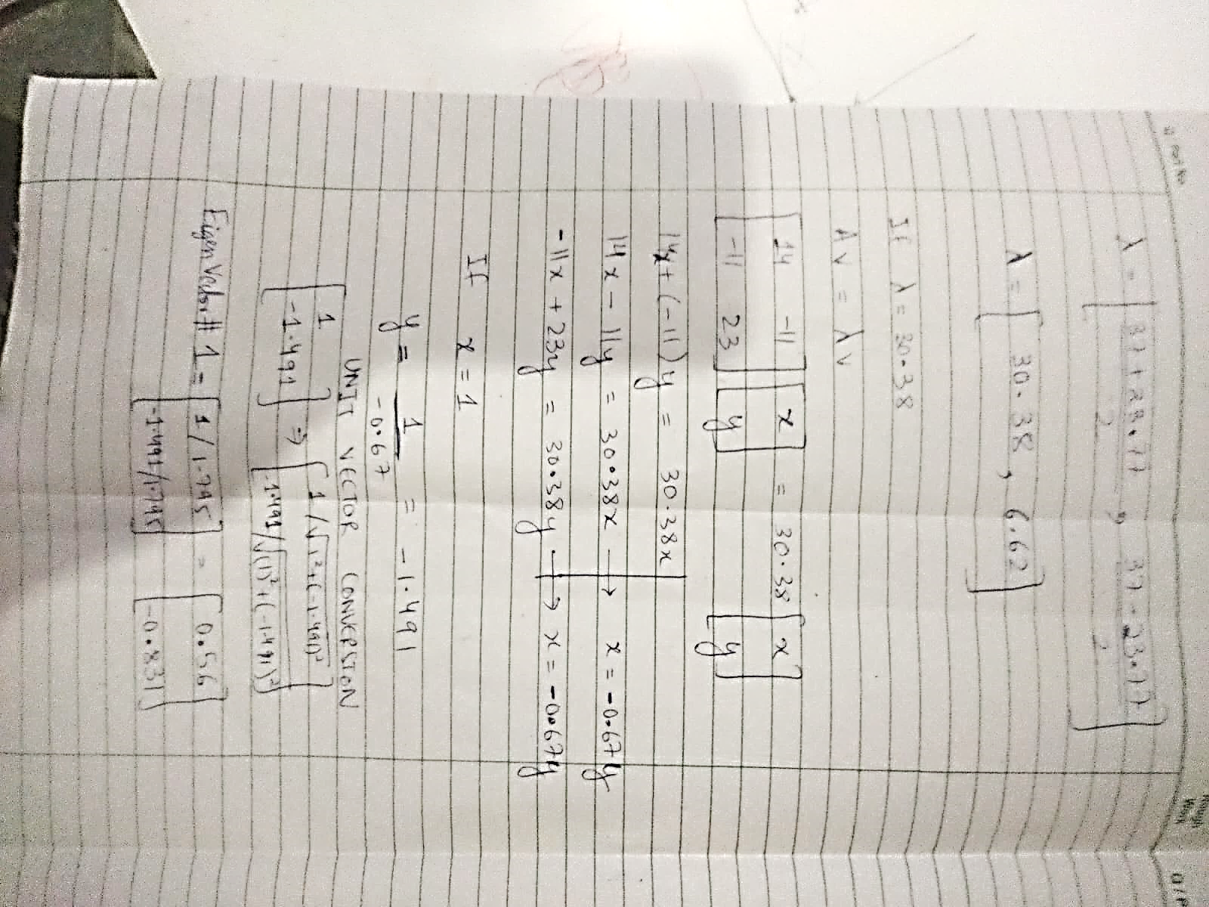

Slide 33
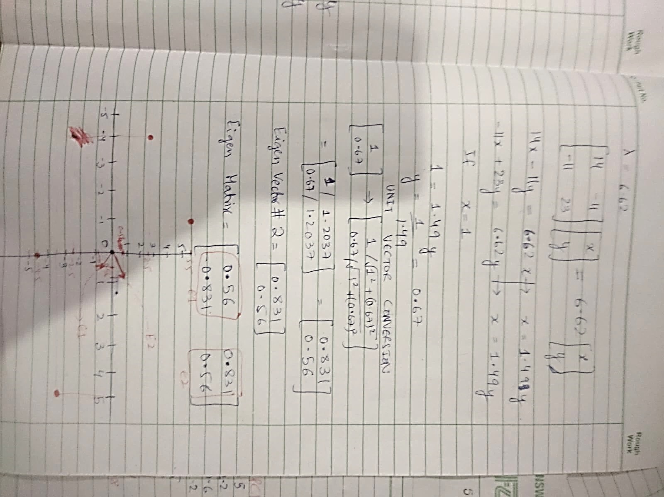

Slide 34
How many Components should we extract?
The motivations for PCA was to reduce the number of features.
The question arises, “How do we determine how many components to extract?”
For example, should we retain only the first principal component, as it explains nearly half the variability? Or, should we retain all eight components, as they explain 100% of the variability?
Retaining all eight components does not help us to reduce the number of dimension
The answer lies somewhere between these two extremes.

Slide 35
How many Components should we extract?
The criteria used for deciding how many components to extract are the following:
The Eigenvalue Criterion
The Proportion of Variance Explained Criterion
The Scree Plot Criterion
The Minimum Communality Criterion

Slide 36
1. The Eigenvalue Criterion
An eigenvalue of “1” would mean that the component would explain about “one variable's worth” of the variability.
The rationale for using the eigenvalue criterion is that each component should explain at least one variable's worth of the variability, and therefore, the eigenvalue criterion states that only components with eigenvalues greater than “1” should be retained.
Note that, if there are fewer than 20 variables, the eigenvalue criterion tends to recommend extracting too few components, while, if there are more than 50 variables, this criterion may recommend extracting too many.

Slide 37
2. The Proportion of Variance Explained Criterion
Specified by the analytst that how much of the total varability would like the principal components to account for
Selects the components one by one until the desired proportion of variability explained is attained.
For example, suppose we would like our components to explain 85% of the variability in the variables.
Notes:
choose components 1–3, which together explain 86.057% of the variability. However, if we wanted our components to explain 90% or 95% of the variability, then we would need to include component 4 along with components 1–3, which together would explain 96.368% of the variability.

Slide 38
3. The Scree Plot Criterion
A scree plot is a graphical plot of the eigenvalues against the component number.
Scree plots are useful for finding an upper bound (maximum) for the number of components that should be retained.
Most scree plots look broadly similar in shape, starting high on the left, falling rather quickly, and then flattening out at some point.
This is because the first component usually explains much of the variability, the next few components explain a moderate amount, and the latter components only explain a small amount of the variability.
The scree plot criterion is this: The maximum number of components that should be extracted is just before where the plot first begins to straighten out into a horizontal line.
Sometimes, the curve in a scree plot is so gradual that no such elbow point is evident; in that case, turn to the other criteria.

